Slide 1
Engaging Students in “Active Learning”

Slide 2
Imagine this…
Once upon a time, two people were sitting in the Quad…

Slide 3
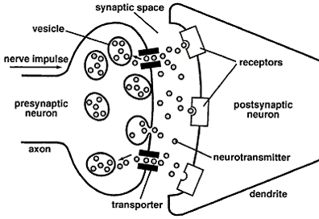
Neuroscience & Learning
When exposed to any stimulus, neurons are activated.

Slide 4
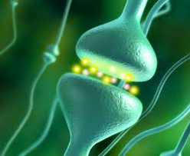

Slide 5
http://video.nationalgeographic.com/video/ng-live/mapping-brain-lecture-nglive?source=relatedvideo
(3:50-9:17)
http://ngm.nationalgeographic.com/2014/02/brain/voyage-video

Slide 6
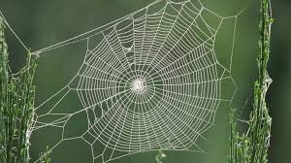
Principles
Every activation has its own pattern.
Think of it as a web (spider web). Web after web is activated in our brain; some of them are “laid down” (stored) in our brain; others are not.
Some become permanent immediately and effortlessly; others decay and are lost. What makes for immediate permanence?

Slide 7
“When adults learn, they build on or modify networks that have been created through previous experience or learning.” (Barkley, E.F., p. 18).

Slide 8
Let’s Review Piaget…
Key Concepts:
Schemes
Assimilation
Accommodation
Disequilibrium
[“When adults learn, they build on or modify networks that have been created through previous experience or learning.” (p. 18).]

Slide 9
So there is NO new learning without disequilibrium.
How does disequilibrium occur?
Can we (as teachers) make that happen? (Do we really want our students to actually struggle?)
Let’s review…

Slide 10
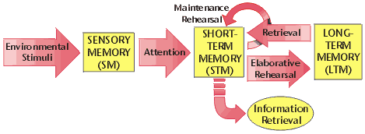
Memory: Atkinson-Schiffrin Model

Slide 11
What makes the difference in ease/difficulty of learning?
Some images, ideas, concepts, experiences are Immediately and Effortlessly stored permanently!
Surprise; emotional load, etc.

Slide 12
What makes the difference in ease/difficulty of learning?
Effortful : A general principle: The longer we hold a concept in working memory, the more likely it is to be moved to permanent storage.
But we have a problem: “Attention Span”

Slide 13
Cognitive Strategies
Levels of processing:
The information “makes sense”…is “meaningful.”
Elaboration of existing schema:
Fits in with what one already knows about how the world works (re-conceptualization)

Slide 14
Key Concepts
Connection
Meaning
Usefulness
Novelty
Elaborative

Slide 15
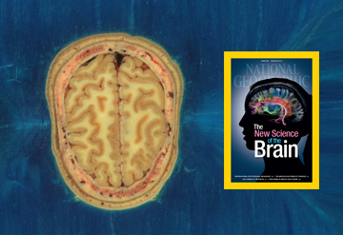
For your leisure reading & viewing…
Iran-Nejad, Asghar (1980) . The schema : A structural or a functional pattern. Center for the Study of Reading Technical Report ; No. 159. Champaign, Ill. : University of Illinois at Urbana-Champaign, Center for the Study of Reading.
The New Science of the Brain, National Geographic, February, 2014.

